Slide 1

Quality Management
For Mouse Gesture Pattern Recognition Development
By Artificial Neural Network
Team Member:
Gang Hu (ID 5258235)
Beichen Li (ID 4841867)
Yi Huang (ID 5759641)
Malik Qasaimeh (ID 5266327)
April, 2007

Slide 2
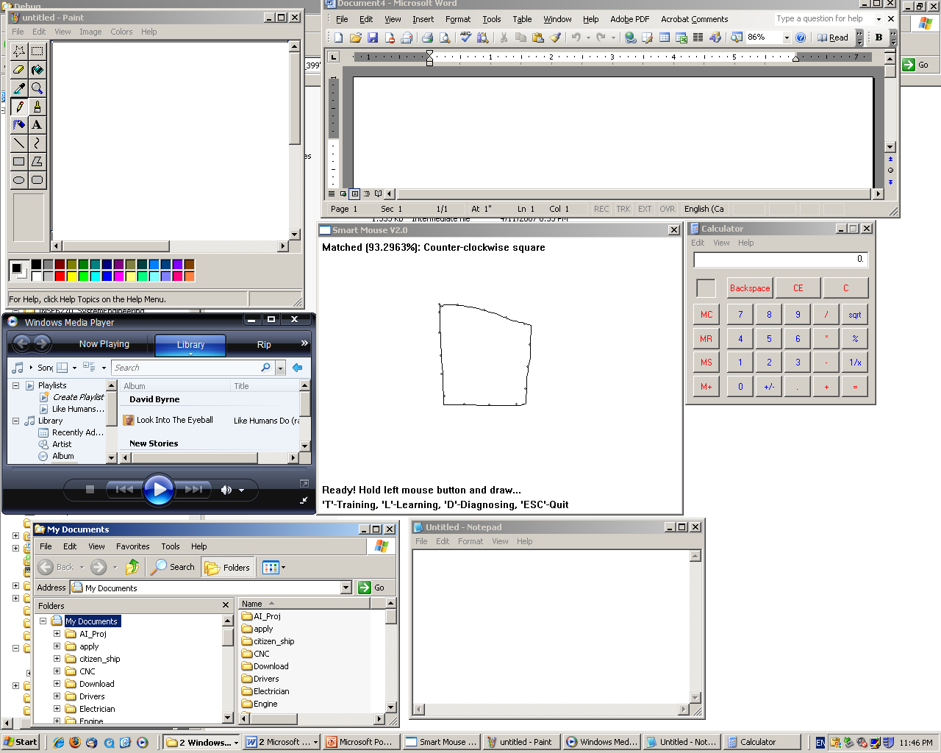
Project Introduction
What this project did?
This project is to combine the knowledge and methods of quality based system engineering and the ANN knowledge to program, design and develop an ANN of Mouse Gesture recognition application ANN moue gesture recognition application
An integrated measurement/test tool that can help us to tweak and tune the ANN performance.
Quality measurement is a key for this project, and many testaments are done for better tuning tweaking the ANN model.
The quality improvement is divided into two ways, performance and features.

Slide 3
Quality Planning
Establish the Project
Mission and Vision Statement
To develop an ANN program &application which can identify a user's mouse movement on a small user interface window which locates at the corner of windows screen.
To make a unique, creative, user friendly and lead product in the market; to provide core code with free download for those who are interest in how it works and want to learn ANN application programming.

Slide 4
Quality Planning
Establish a Team to do the Planning
Project Manager: Gang Hu
Product Engineer (software developer): Gang Hu & BeiChen Li
Quality Engineer: BeiChen Li and Yi Huang
Support Engineer: Malik Qasaimeh

Slide 5
Quality Planning
Plan the Execution of the Project
1st week: developing the objective which include project and mission statement
2nd week: team planning
3rd -- 4th week: identifying customers and collecting customer requirements
5thweek- 10th week: product design and software development
11th week: product test and quality assurance
12th week: quality improvement and verification

Slide 6
Quality Planning
Identify Customers and Discover their Needs
We aim at four categories of customers as follow:
1) Novices and beginners who are not familiar with the computers and operating systems and who want to have simple tools to access their intended programs. We provide them with our product which is easy to use, intuitive and interactive and has simple patterns to use.
2) Windows platform hobby users (advanced users) who want to shorten the operation time to access their programs/ applications efficiently.
3) The users who need to access their programs and application based on authentication process by using the product which is designed to recognize their gestures and signatures.
4) Developers and programmers who are interested in the artificial neural network programming. Our product delivers with free codes and detailed documentation as well as free-use license.

Slide 7
Quality Planning
Customer requirements
1) Quick response
2) Simplicity
3) Flexible
4) Accuracy
5) Expandability (learning ability)
6) Usability
7) Maintainability
8) Reliability
9) Functionality
10) Price
11) Availability
12) Modularity
13) Error-tolerance
14) Reusability
15) Interoperability

Slide 8
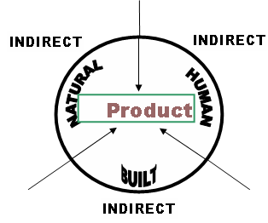
Quality Planning
Develop the Product
Design requirements come from
environment. The environment
can be divided into Natural
environment, built environment,
and human environment.

Slide 9
Quality Planning
Develop the Product
Technical requirements are design characteristics that describe the customer requirements as expressed in the language of the designer or engineer. This product has following seven features:
1) Mouse gesture recognition
2) Mouse drawing sequence pattern classification (or signature)
3) User friendly interface
4) Easy to use
5) Suitable for the people from beginner to advanced users
6) Great learning ability and expandability
7) Help users to open specific or customized application/programs just by mouse movements

Slide 10
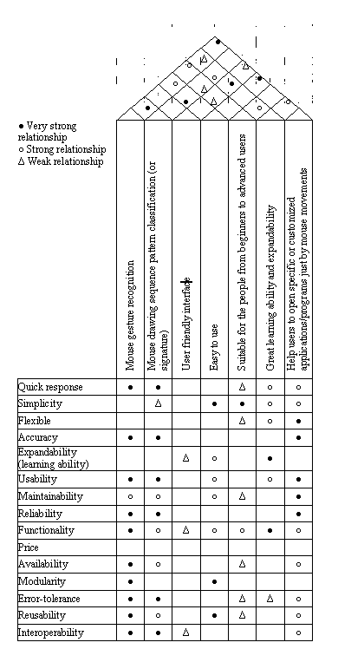
Quality Planning
Develop the Product
Relationships between the customer requirements and technical requirements:

Slide 11
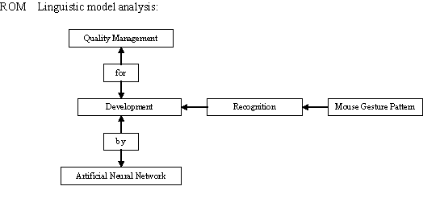
Quality Planning
Develop the Process

Slide 12
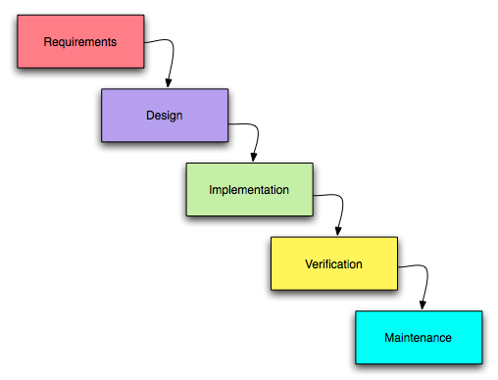
Quality Planning
Develop the Process
To produce the product features, we have six steps for the product development .

Slide 13
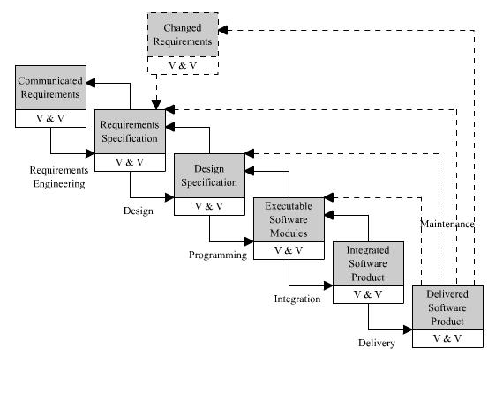
Quality Planning
Develop the Process-Design Feedback Loop

Slide 14
Quality Planning
Optimize Self Control and Self Inspection
Every member has a clear understanding of what he is supposed to do in the project.
Team members review timely their actual performance in the process.
Every one, especially the software developer, must have the ability and desire to regulate the process for minimum variation.
The project is implemented in a friendly quality oriented environment. Team members consider quality as the number 1 priority. The software developers took more responsible for the quality of their work and applied the self-inspection in the design process.

Slide 15
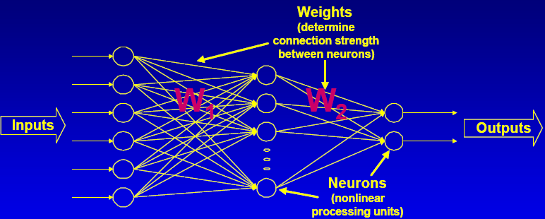
About Artificial Neural Network (ANN)
Some properties of a brain works :
- It can learn with/without supervision
- It is tolerant to damage
- It can process information extremely efficient
- It can generalized
ANN features:
An artificial neural network attempts to mimic
this amount of parallelism within the
constraints of computer, and in doing so,
display a number of similar properties to a
biological brain.
- Generic nonlinear functional element – can implement any MIMO mapping function to arbitrary accuracy (universal approximate)
- Need to be “trained” with data
-Supervised training: applied when we already have examples data; Demo
-unsupervised training: applied learning algorithms to adjust the weights. Demo
- Parallel architecture nature, but can be implemented on serial computer
- Black box – difficult to understand inner workings
- Useful for modeling data-rich/theory-poor processes, such as pattern recognition, non-linear control, prediction, skill game AI (like car driving), and so on.

Slide 16
Feature Vector Selection for Artificial Neural Network
2.2 ANN Model Design for Mouse Gesture
Step 1: Selection of feature vector for neural network in this project
We consider the mouse movement on the screen as input, the mouse button as a switch to active the collection of mouse movement points and response to ANN recognition. So, we choose 16 points as vector, and each include X and Y axial value. Therefore, we have 32 input data.
Usable gestures can not be complicated drawings, as they must be performed on the limited area of the screen and relatively easy to be repeated with a significant similarity. We propose relatively simple gestures as possible, e.g. the examples presented on the Fig.1 Finally, we distinguished different pattern as the basis for the further experiments.

Slide 17
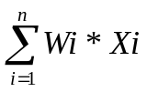
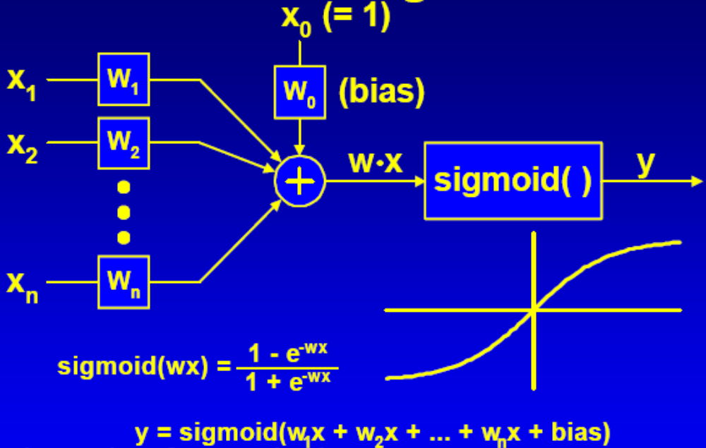
Model of Each ANN Neuron In This Project
Each single neuron structure:
- Each neuron has an activation function which is called activation function. It sums all weight-adjusted input value to give the activation value.
- Output y = W * Sigmoid( ), in which, inputs Xi, i=1,2, …., n
- Threshold can applied, if it is less than specific value, output may be zero.
-ANN functionality defined by architecture, weights and training process.

Slide 18
Neural Network Training Method In This Project
Neural Network Back-propagation training processes:
Here, a feed-forward network i denoted by inputs, j hidden neuron units, and k output units, L learning rate, E error, neuron output O, target output T, for example, Output ‘O’ from a neuron k will be given Ok and target output is given Tk, Error is given Ek, etc.
1. Start from output layer:
The error value for each neuron
Ek = ( Tk – Ok ) * Ok * ( 1 – Ok )
To change the weight between a unit j in the hidden layer and an output unit k, Wjk += L * Ek * Oj
2. Then adjust hidden layer’s weights:
Ej = Oj * ( 1 – Oj ) * Wij += L * Ej * Oj
3. This entire process is repeated until the error value over all the training has been reduced to an acceptable level
Extra ANN techniques applied in training process for this project:
Adding Momentum to prevent local minima: Replace Wij+=L* Ej *Oi with Wij += L * Ej * Oi + m * ^ Wij
-Adding jitter (noise) to prevent ANN over-fit to the training set, therefore, lost generalized ability.

Slide 19
Neural Network Training Method In This Project
Experiment data (input vector sets) generation for training Output vector for training
Before we feed the effective input vector into neural network, we should have exact output information (vector) on hand, so the ANN can know the right direction to adjust the weights by back-propagation training method.
Each output pattern vector corresponds to each input vector. As the input data we already known the exact shape (standard shape, like standard triangle and square), so the type of pattern can be easily determined according to the relationship between the output and input. As we found that each classification type has an output neuron is a better case, so the output vector was built by related input

Slide 20
Neural Network Training Method In This Project
ANN model and software work flow in this project
Two extra ANN techniques applied to improve ANN performance
1) Adding Momentum to prevent local minima:
The back-propagation algorithm attempts to reduce the error of the neural network a little in each epoch. We can imagine the network having an error landscape. Each iterations, the algorithm determines the gradient of the error at current point in the landscape and attempts to move the error value toward a global minimum.
Replace Wij+=L* Ej *Oi with Wij += L * Ej * Oi + m * ^ Wij.
2) Adding jitter (noise) to prevent ANN over-fit to the training set, therefore, avoid losing the generalized ability.

Slide 21
Neural Network Training Method In This Project
Test and verify the ANN model
After complete the training process, the big and crucial next step is the verification and tuning procedure which can not only verify the model effect, but also help to tune the ANN parameters. The main ANN parameters need to tweak and tune are as follow
a) Sigmoid response coefficient (1.0); b) Bias (1.0); c) learning rate (0.1); d) error threshold (0.7); e) Epoch threshold; f) Momentum rate (0.5); g) Jitter rate (0.2)

Slide 22
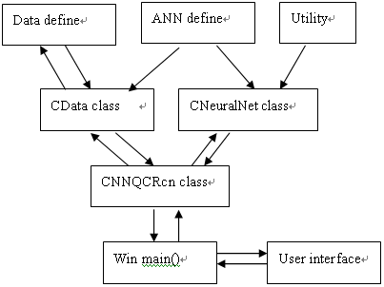
Mouse Gesture Program Design and Implementation
The ANN model was built by Visual C++ on windows. The main program structure for this project was shown in figure

Slide 23
Mouse Gesture Program Design and Implementation
The whole procedures are explained as follow step by step in figure 4:
Collect out-of-control data &generate input vector
Scale data
Back-propagation to adjust weights in training or update NN output in testing mode
Examine the output data
Obtain corresponding shift type base on the NN result

Slide 24
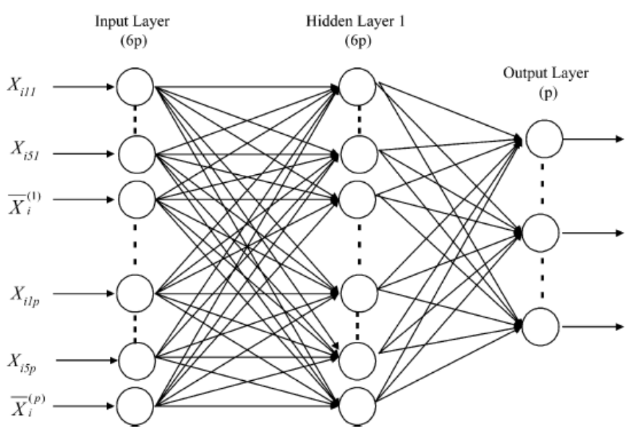
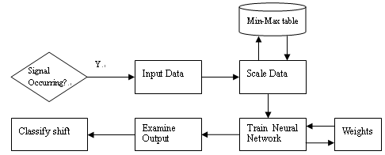
Architecture of Neural Network for this project
NN Structure for this project:
NN work flow in this project:
1). Collect out-of-control data &generate input vector
2) Scale data
3).Back-propagation to adjust weights in training or update NN output in testing mode
4).Examine the output data
5).Obtain corresponding shift type base on the NN result

Slide 25
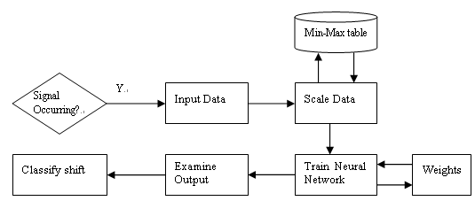
Mouse Gesture Program Design and Implementation cont …

Slide 26
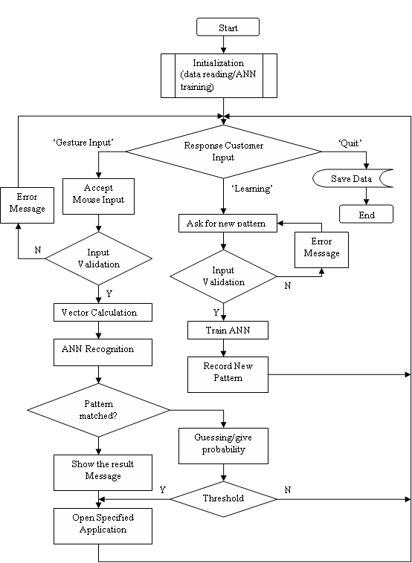
Mouse Gesture Program Design and Implementation cont …
The main program flow chart is shown in the figure

Slide 27
Mouse Gesture Program Design and Implementation cont …
we can show how the program run and how it handles the user input clearly. The main procedure separate into ‘Gesture Input’, ‘Learning’ and ‘Quit’ subroutines which response the user keyboard input. If it is ‘Gesture Input’ the program sample and collect the user mouse movement on the input window and then apply ANN to classify the pattern. If the pattern is not sure, then give the guessing/ possibility value. If it is in the ‘learning mode’ the program turn into a student, it can learn any input mouse gesture, record the user new gesture name and specified application name which the user want to open by this gesture

Slide 28
Quality Control
Team Contract (Quality)
Positions and Responsibilities:
Project manager: Gang Hu
Product engineer (software developer): Gang Hu & BeiChen Li
Quality engineer: BeiChen Li and Yi Huang
Support Engineer: Malik Qasaimeh
Terms and condition

Slide 29
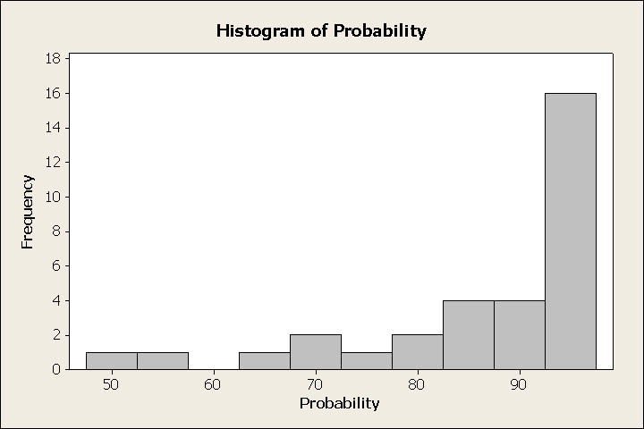
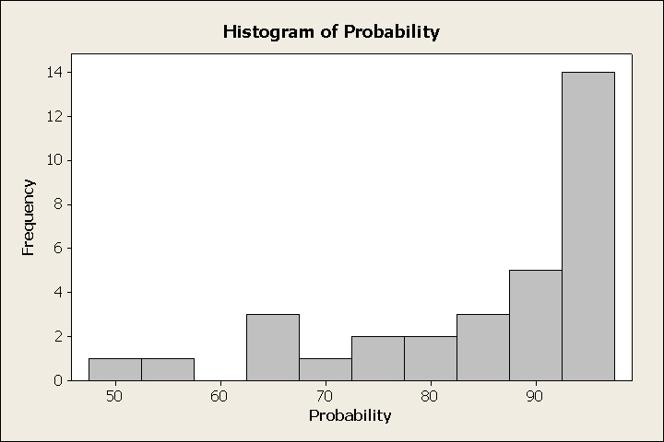
Quality Control
Quality Measurement and Quality test
Four essential parameters- Learning Rate, Error Threshold, Momentum Rate, and Jitter Rate.
Histogram of probability when Jitter Rate is 0.05 Histogram of probability when Jitter Rate is 0.14
As a result, we could set the Jitter Rate either with 0.05 or with 0.14.

Slide 30
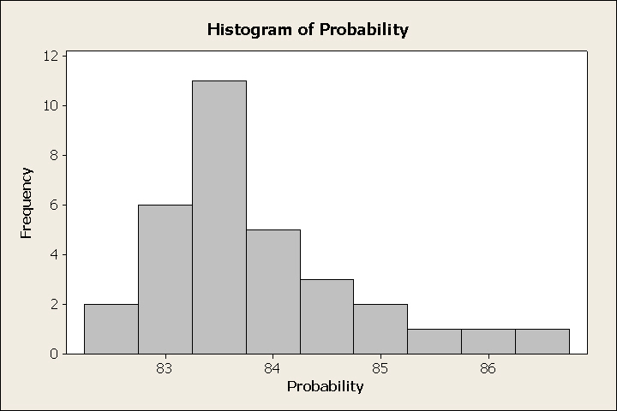
Quality Control
Quality Measurement and Quality test
Histogram of probability when the Learning Rate is 0.6

Slide 31
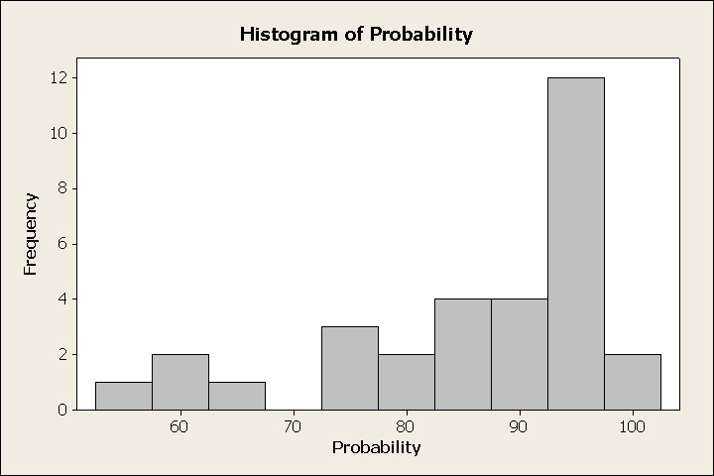
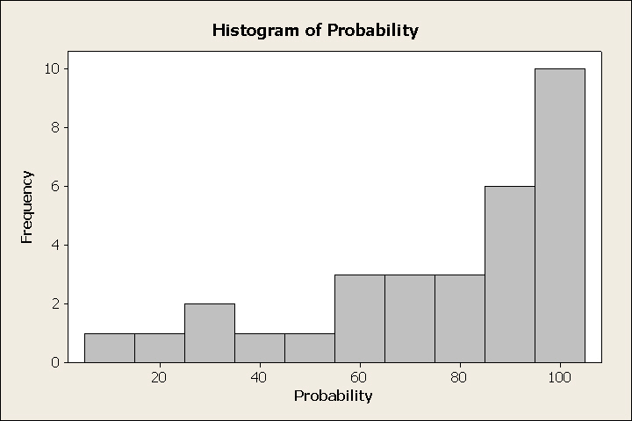
Quality Control
Quality Measurement and Quality test
Momentum Rate is 0.9 Momentum Rate is 0.1

Slide 32
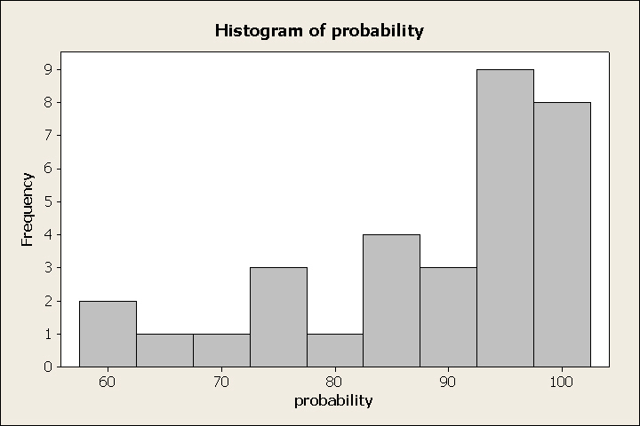
Quality Control
Quality Measurement and Quality test
Error Threshold is 0.02

Slide 33
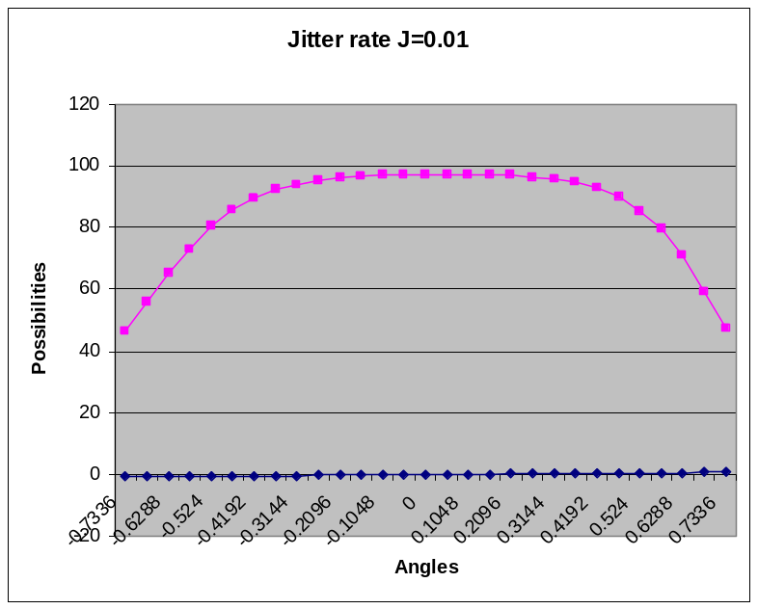
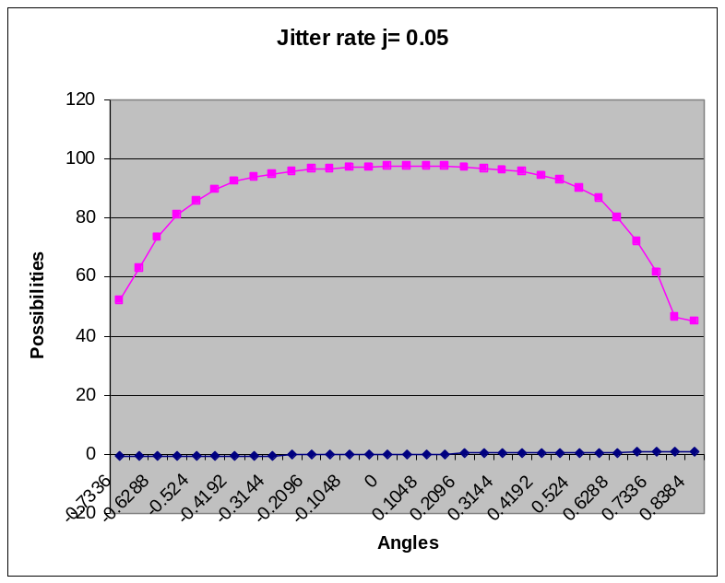
Quality Control
Quality Measurement and Quality test
we provide more detailed study that analyses the performance of guessing with different values for Learning Rate, Error Threshold, Momentum Rate, and Jitter Rate.

Slide 34
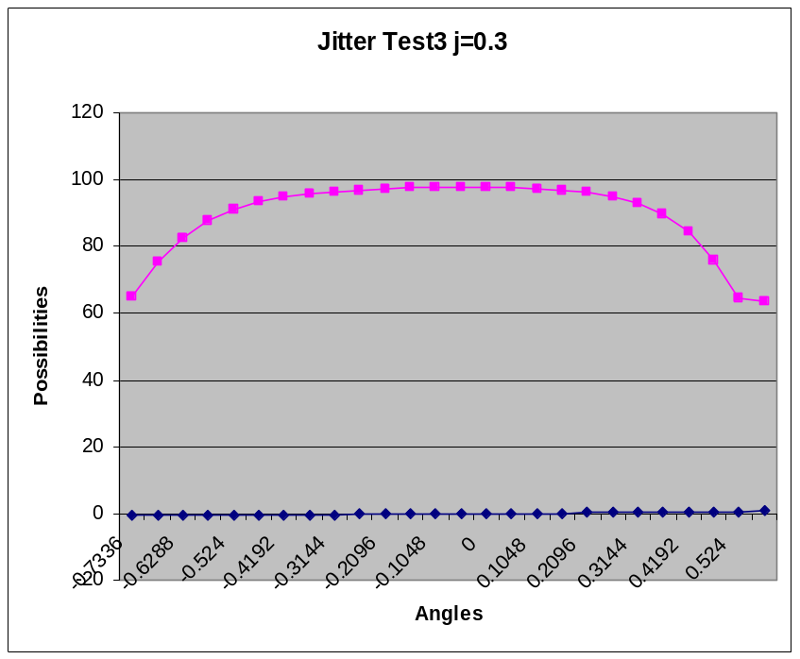
Quality Control
Quality Measurement and Quality test
Clearly the plots show that by compare vitiation of the plots, j=0.3 it could be the best value in the range of [0.05, 0.14].

Slide 35
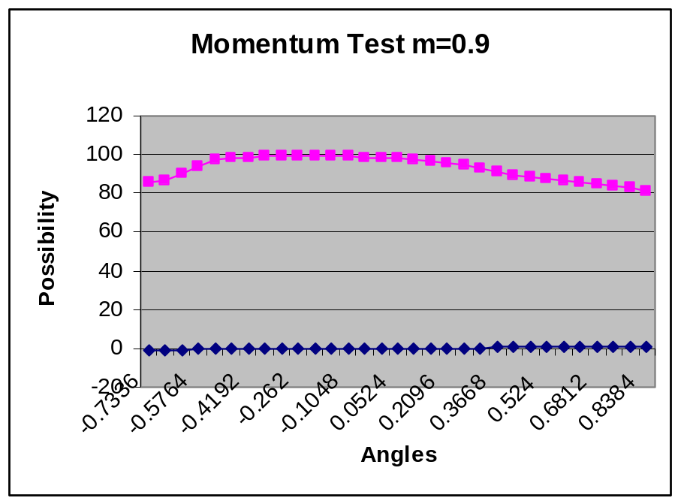
Quality Control
Quality Measurement and Quality test
Tests are done with momentum rate equal to respectively 0.1,0.9, 1.2.
The graph above shows that m=0.9 cloud be the optimum value for momentum rate.

Slide 36
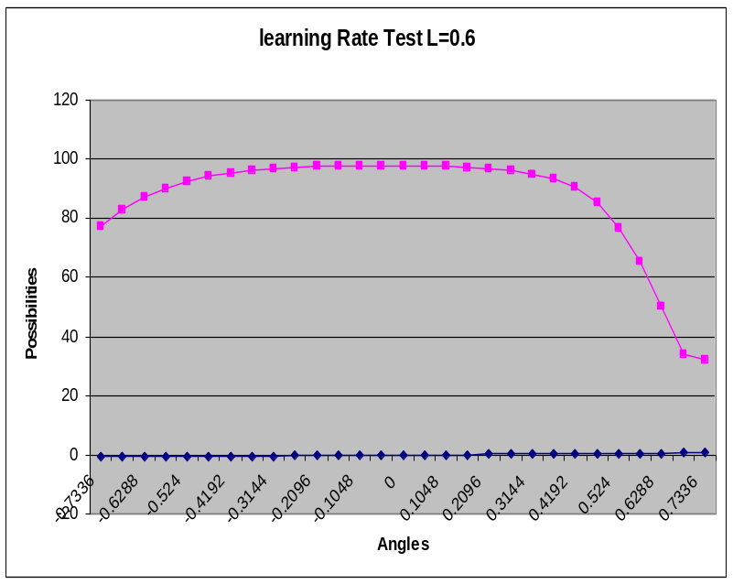
Quality Control
Quality Measurement and Quality test
Tests are done with learning rate equal to respectively 0.1,0.6, 1.2.
The experiment shows that the optimum value for learning ability can be found with L=0.6

Slide 37
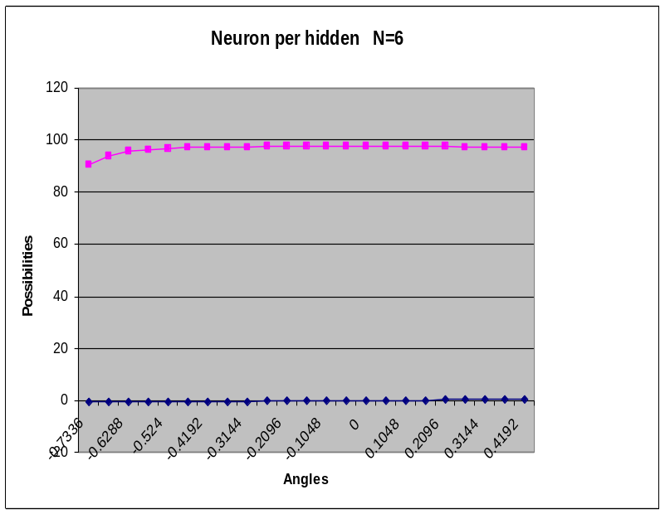
Quality Control
Quality Measurement and Quality test
Tests are done with Neuron per hidden equal to respectively 6, 8, 16.
The figure shows clearly that N=6 could be the optimum value for neuron per hidden parameter

Slide 38
Quality Control
Quality Control Tools
Communications: Brainstorming, Fishbone diagram
Control charts
Schedule: Gantt chart

Slide 39
Quality Improvement
Product quality improvement
Based on some kind of balance between accuracy and generalization, we achieved some improvements as follow:
1)No action sequence is demanded for the basic shape recognition
2) The right mouse clicking action is switched to left one, which is more convenient for most program users.
3) Better generalization
4) The updated version leaves customer gesture drawing trace with sample vector point showing on screen.
5) Automatic generalization for test data is presented to achieve better ANN performance
6) The updated version allows the automatic test and measurement to evaluate the ANN performance.
7) The rotation and position changes are recorded into file for the future analysis use.

Slide 40
Quality Improvement
Product quality improvement
8) The ANN basic shapes are recorded and trained weights are saved into a file, so no training is required for next start.
9) ANN can be learned by the user data/new gestures, which provides the program the self-learning ability.
10) Such basic and easy mouse gesture patterns as up, down, lift and right are used for some most frequently used applications.
11) Some more complicated patterns could be reserved for advanced users or application use.
12) Users can change the specific applications which will be opened.
13) The program is named as Smart Mouse which is more attractive and easy to understand by users.
14) User interface window is created to be larger than before.

Slide 41
Quality Improvement
Prove the Need
We combined this step into our whole design procedure. That is we separated the product development into a few small parts. After we finished each small prototype part, we asked our customers to test and verify if it satisfied their original need. Then based on the feedback, we could try to improve our design.

Slide 42
Quality Improvement
Identify Potential Team Improvement Projects
We establish our team in flexible ways.
1) Communication: The first barrier is the language.
2) Schedule: We only can choose the weekday night time for our group meeting.
3) Background: We try to take advantage of each member’s specific work and study background.
4) Commuting issue

Slide 43
Quality Improvement
Diagnose the Possible Causes of Team Failure
Provide Remedies and Prove that the Remedies are Effective
1. No Trust between Team Members
We separated the project duties clearly and make sure each member understands his position and what he should do base on his own interest and background.
2. Ineffective Interaction and Unproductive Team Meetings
Before each meeting, we have clear goals, and then we have brainstorming, and ask each member to well prepare and take part in positively.
3. Poor Role Clarity
From early stage of project, we define the role and responsibilities for each team member.
4. Poor Time Management
We make a clear meeting schedule and apply some software tools to help us to deal with the time management under control. And every time before the group meeting, the project manager sends the email notification to every member.

Slide 44
Conclusion
In this project, we applied quality base engineering knowledge to develop a software product which is an ANN moue gesture recognition application with an integrated measurement/test tool that can help us to tweak and tune the ANN performance. All the program and the ANN model is programmed in C++ which could provide more flexibility, higher execution speed and more expandable and under thorough control. Also we used two extra ANN techniques to improve the performance by adding Momentum (friction) and Jitter (noise) in the training and result updating procedure. The test and measurement are very important for this project program (especially the ANN model). We built a separate test program to find the relative best parameter settings for the ANN in which consider the balance of accuracy and generalization ability.
All in all, we learnt a lot useful knowledge through this project development and gain hands-on experience on how to apply the system quality engineering to guide a whole software development procedure. And also this project especially in the ANN related to quality control field.

Slide 45
Thank You!

